Slide 1
Introduction to Database
Chapter Five Computer Company Problem

Slide 2
Content
A. Problem
B. Solution

Slide 3
A. Problem
ProgLtd is a company that places computer programmers at temporary jobs. They keep track on each programmer: the programmer's identification number, the programmer's last name, the programmer's first name, the programmer's rank (Junior, Senior ...), gender, his/her hourly rate and what languages the programmer knows.
Beside, each programmer has been issued a badge which is used for enter their office. On each badge has following information: badge’s code, the programmer's identification number, issued date.

Slide 4
ProgLtd deals with clients who may require programmers who know a particular programming language. Once a programmer is assigned a temporary job, ProgLtd would like to keep track of when he/she started the job, the total number of hours he/she is expected to spend at job and the date he/she finished the job. That is in addition to the client name and phone number where the temp has been assigned.
Let’s design DB diagram for above requirements

Slide 5
B. Solution
Logical Analysis
Physical Analysis

Slide 6
1. Logical Analysis
1.1. Identify Entity
1.2. Identify Attribute
1.3. Identify Primary Identifier
1.4. Identify Alternative Identifier
1.5. Identify Mandatory Attribute
1.6. Identify Relationship

Slide 7
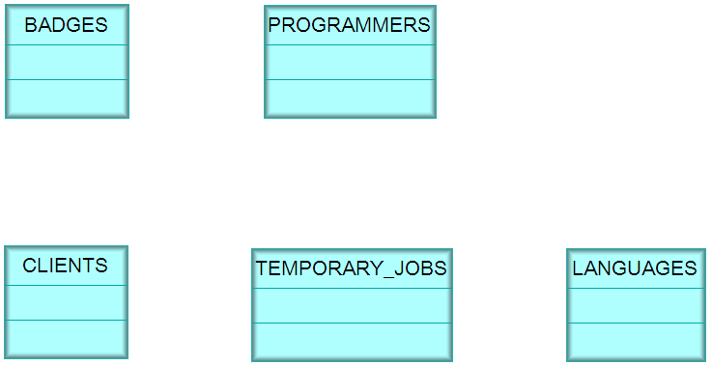
1.1. Identify Entity

Slide 8
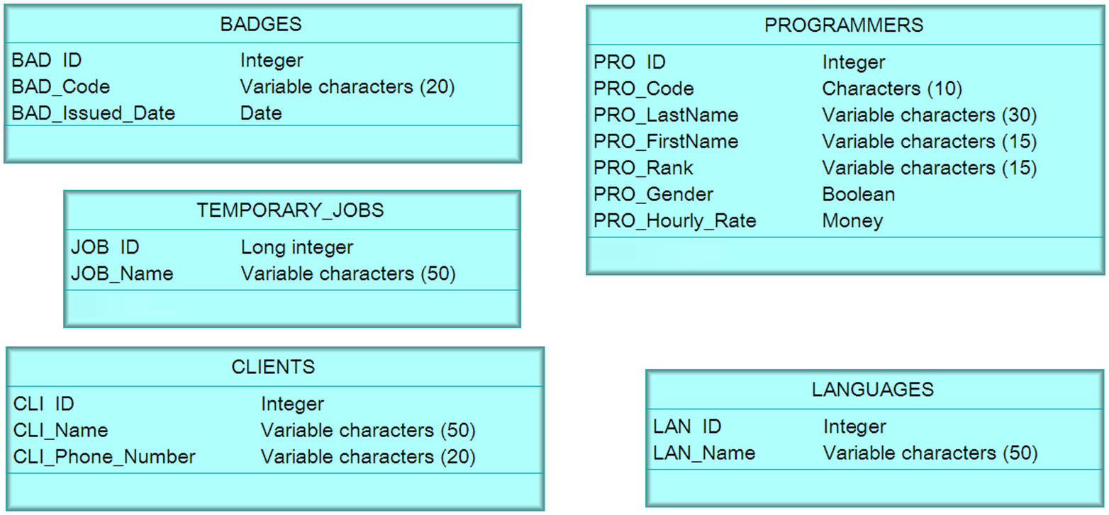
1.2. Identify Attribute

Slide 9
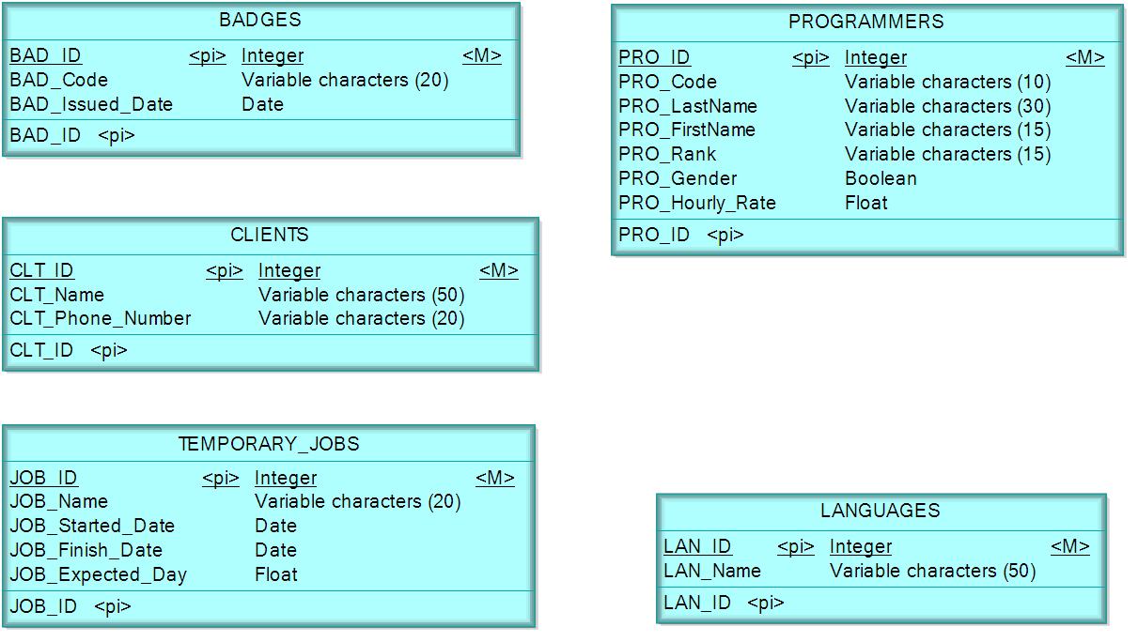
1.3. Identify Primary Identifier

Slide 10
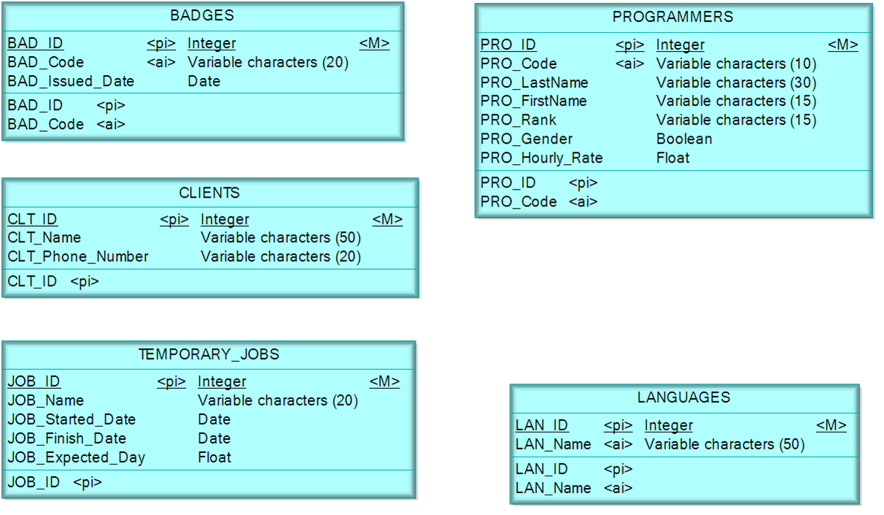
1.4. Identify Alternative Identifier

Slide 11

1.5. Identify Mandatory Attribute

Slide 12
1.6. Identify Relationship
1.6.1. Identify Maximum Cardinality
1.6.2. Identify Minimum Cardinality

Slide 13
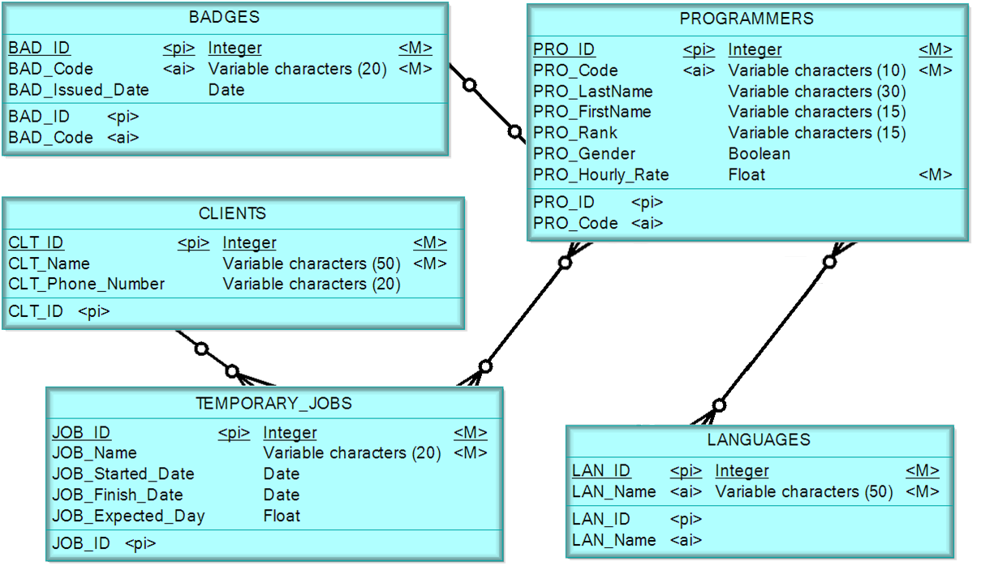
1.6.1. Identify Maximum Cardinality

Slide 14
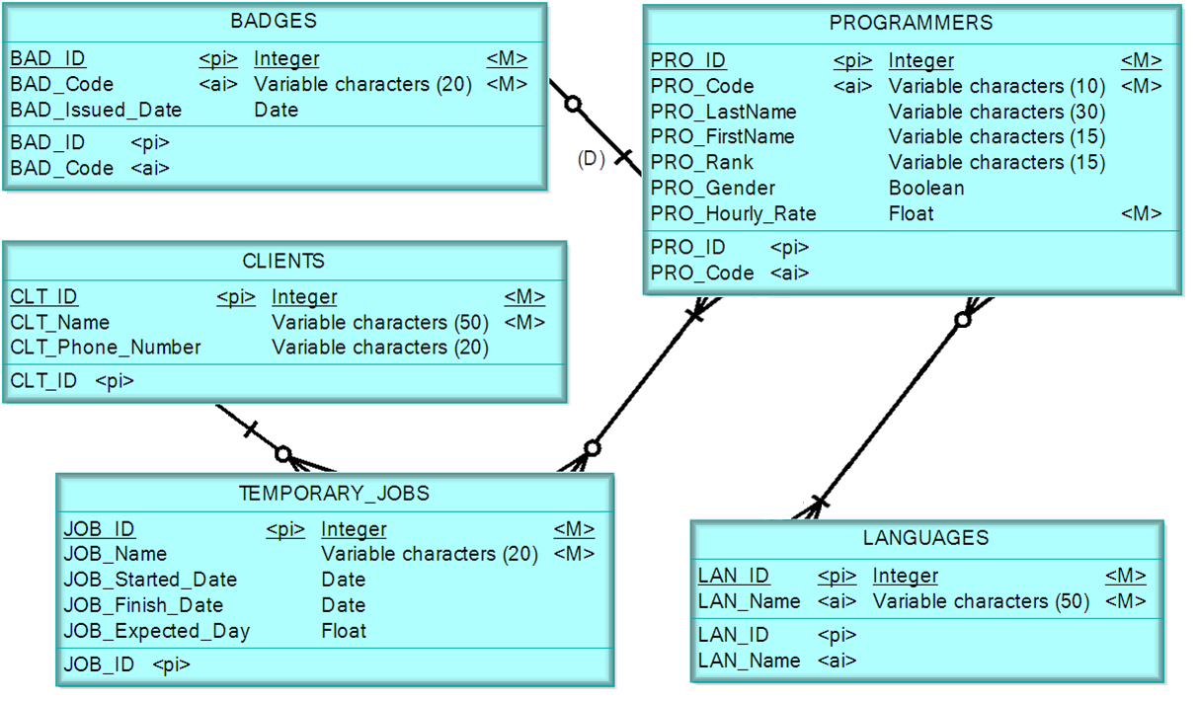
1.6.2. Identify Minimum Cardinality

Slide 15
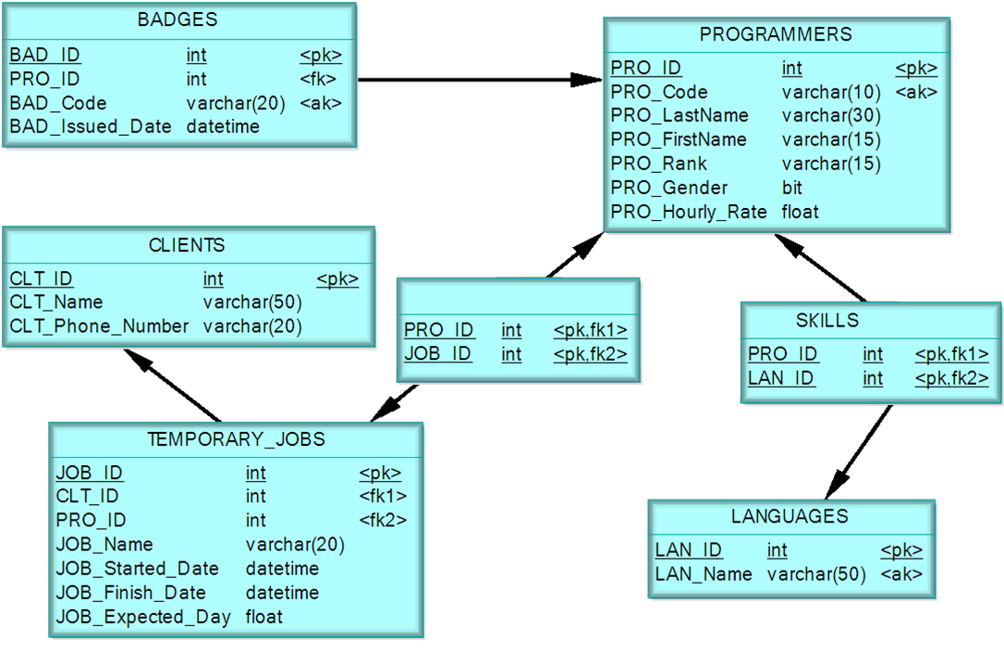
2. Physical Diagram

Slide 16

?

